Slide 1
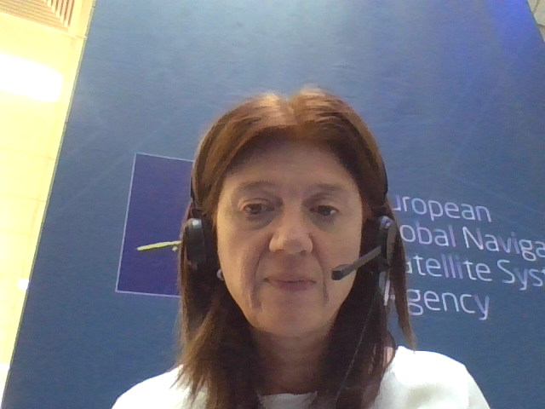
Galileo Timing and Synchronisation Applications
ITSF 2020
Valeria Catalano
05 November 2020

Slide 2


Critical Infrastructure

Slide 3


GNSS Timing capability is at the core of most vital infrastructures
Telecommunication applications
Digital Cellular Network (DCN)
Public Switched Telephone Network (PSTN)
Professional Mobile Radio (PMR)
Satellite Communication (SATCOM)
Small cells
Energy operators
Phasor Measurement Units
Finance applications
Banks
Stock Exchanges
GNSS provides a unique oﬀering to the T&S user communities by delivering a free, stable and very accurate time and frequency source available worldwide

Slide 4
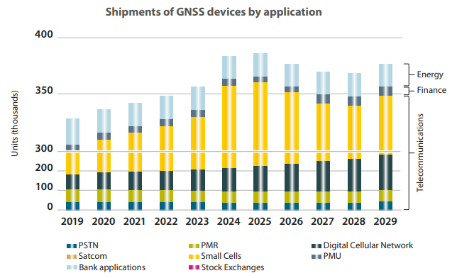

Regulation and 5G to seize new market opportunities
T&S highly specialised market is driven rather by strategic importance than the mere size of the market
Energy and Finance benefit from regulation implementation
Telecom still the most prominent market for GNSS
5G: a huge potential market for GNSS, bringing challenges and opportunities
Overall, GNSS T&S shipments are expected to grow at a CAGR of 1.4% over 2019 – 2029

Slide 5

Galileo is showing superior performances
Galileo is currently only the fourth constellation of choice behind GPS, Glonass and Beidou also in Europe
However, already today Galileo is showing superior performances compared to alternative constellations
It is therefore of paramount importance to address decision makers with a clear value proposition based on measured parameters focusing on accuracy and robustness
Jan 2018: the Markets in Financial Instruments Directive* regulations in Europe require time-stamping of automated transactions with an accuracy of 100 μs.
Opens up a window of opportunity for an increasing Galileo use
*(2004/39/EC, MiFID II)

Slide 6


Numerous activities are being undertaken to foster R&D, innovation and the development of novel applications and GNSS components
The time to act is now – window opportunity 2020-2025
Developing a T&S solution offering built upon Galileo differentiators
Developing a Galileo-based timing receiver trough R&D
Improving awareness and to ensure the sharing of best practices
Ensuring, together with EC, a Galileo-friendly legislation framework

Slide 7
EU-funded R&D towards a robust timing receiver
Two GSA Fundamental Elements projects aim to support the market adoption of Galileo as a reliable time source
GIANO (Galileo based Timing Receiver for Critical Infrastructure Robustness), KO Feb 2019), aims at developing an innovative Galileo-based timing receiver based on flexible architecture, improving resilience and robustness of European Critical Infrastructures at a reasonable cost.
GEARS – (The Galileo Authenticated Robust Timing System), KO Jul 2019, has the objectives of:
Improving performances and resilience of Galileo and GNSS Timing receiver
Developing and demonstrating the effectiveness of unique Galileo services to operators
Strengthening market adoption

Slide 8
A Galileo Timing Service can be released leveraging the outcomes of R&D projects
Application Offerings | Description | TLC | Power grids | Finance | Labs
1. Galileo time integrity leveraging OS in the first place, and then OS-NMA after 2021 | Validation and performance assessment of the timing information disseminated by the Galileo System | ✓✓ | ✓✓ | ✓✓ | ✓✓
2. Trusted time distribution and remote audit leveraging OS in the first place, and then OS-NMA after 2021 | Dissemination of UTC time and frequency over Internet using NTP (or PTP) and remote assessment of the client clock synchronisation by providing audits and report | ✓ | ✓ | ✓✓ | ✓
3. Certified Time steering and monitoring leveraging OS in the first place, and then OS-NMA (or CAS) after 2021 | Dissemination of precise and accurate time using multi-GNSS Galileo based Time Transfer techniques and a real-time internet link, allowing the real-time monitoring and certification of the time offset between the User Terminal and the Time Reference Facility | ✓ | ✓✓ | ✓ | ✓
4. Robust accurate time leveraging OS in the first place, and then OS-NMA (or CAS) after 2021 | Robustness against GNSS signals and system failures and/or attacks like jamming or spoofing and robustness against failures or attack to communication network | ✓✓ | ✓ | ✓ | ✓✓
Notes:
AO3 is particularly appealing for the power grid market to determine the location of faults along a transmission node improving the accuracy of fault diagnosis and the quality and efficiency of an electricity grids.

Slide 9
Galileo T&S AO#1 “Galileo Timing Integrity” description
AO#1
Galileo Timing Integrity
(Dashboard)
Deliver a time integrity service to the GNSS users, by providing integrity information to improve user timing accuracy as well as positioning.
Basically a key feature that intends to provide users with validation and performance assessment of the timing information disseminated by the Galileo System. This is especially important for critical infrastructure operators
Key Functionalities
Ensure, that the accuracy of the time estimated at user level is within certain limits with respect to the reference time
Improve the integrity of Galileo system by providing to the user a “confidence level indicator” (CLI) of the timing information and by providing satellite clock correction application
Monitor the status of Galileo satellite clocks detecting in real time possible anomalies and generating automatic alerts in case the satellite is considered unusable (which can be named “Time to Alert”)

Slide 10
Galileo T&S AO#2 “Galileo Time Distribution and Remote Audit” description
AO#2
Trusted Time Distribution and Remote Audit
Enable remote assessment of the client clock synchronisation by providing audits and report.
It will allow the dissemination of UTC time and frequency over Internet using NTP (or PTP depending on feasibility), and will enable remote assessment of the client clock synchronisation by providing audits and reports.
Key Functionalities
Trusted distribution of UTC time: done in a cryptographically secured manner via TCP/IP based networks using NTP. However, the AO is not limited to NTP, as also PTPv2 (IEEE1588) or White Rabbit might be used. The utilisation of Public Key Infrastructure (PKI) certificates results in a time that can neither be modified nor tempered.
Remote Audit: The distribution of UTC to the end user is carried out by UT (User Terminal) which receives cryptographically authenticated time from a Time Signal Generator (TSG). While providing UT with time, TSG, who receives UTC time from TRF (Time Reference Facility), simultaneously performs time audits. The logs of all audits logs are being stored in a local database.
Retrospective time verification: Time can be verified retrospectively at any specific past moment, resulting in either a VALID or INVALD response. The determination of the validity of the time is dependent on the maximum predefined offset error between the time at UT and TRF (Time Reference Facility).

Slide 11
Galileo T&S AO#3 “Certified Time Steering and Monitoring” description
AO#3
Certified Time Steering and Monitoring
Improve the stability of oscillators slaved to Galileo by real-time correction streaming
Key Functionalities
Time Signal Generator (TSG)
Service Data Handling (SDH)
User Terminal (UT)
Collecting real-time GNSS observations in RTCM streams from both the UT and TRF
Calculating, in real time, the time difference between the user clock and the TRF reference time
Distributing the real-time oscillator steering data in RTCM streams to the UT
Generating functional flags about the operational status of the TSG, UT, and the internet link between TSG and UT and distributing them to the SDH
Generating functional flags about the availability of the real-time streams from both the UT and TRF and distributing them to the SDH
Calculating the latency of TSG output, the real-time oscillator steering data, with respect to the received real-time GNSS data from the UT and distributing these data to the SDH
Distributing the user account status data to the TSG
Collecting TSG and UT operational status data, the operational status of the link between the TSG and UT to save them in SPFDB
Collecting the latency of the real-time oscillator steering data, the functional flags about the availability of the real-time streams from both the UT and TRF and arranging them in ascii files to save in the SPFDB. These files will later be uploaded to the SMF to produce the KPIs: NTRIP outage and oscillator steering data latency.
  Receiving GNSS signals
  Generating and distributing the real-time GNSS observations in RTCM streams to the TSG
  Collecting the real-time oscillator steering data in RTCM streams from the TSG
  Producing steering corrections, based on Proportional-Integral-Derivative algorithm, from the real- time oscillator steering data received from the TSG, in order to discipline the user oscillator
  Generating the applied historical steering parameters (i.e. oscillator control voltage) file and distributing it to the SDH

Slide 12
Galileo T&S AO#4 “Robust Accurate Time” description
AO#4
Robust Accurate Time
Offer robustness against GNSS signals and system failures and/or attacks like jamming or spoofing and robustness against failures or attacks to communication network
Key Functionalities
Performance: the main functional mission of AO#4 is to be able to synchronise a network of atomic clocks up to thousands km apart using GNSS (e.g. namely GALILEO and GPS) with accuracy up to 2-5ns and stability up to 1e-14 (Allan Deviation evaluated at 24h)
Availability and robustness: to be able to deliver high level of availability providing resilience to ground communication failures and to GNSS signals impairments (interruption/degradation of satellite systems, local jamming and local spoofing)
Scalability to, e.g.: number of nodes, geographical coverage, network reconfiguration, clock performance at each node, etc.
Maintainability: thanks to the scalability feature it is quite easy to move out one node for maintenance
Security: AO#4 offers a multi-layer approach to authentication, integrity and confidentiality. All layers are implemented through different asymmetric crypto certificates. All communications are point to point and each point-to-point link takes place on a dedicated virtual network, all data transmitted is signed using a certification authority kept internal to the system (all nodes of the network are manually pre-loaded with CA keys)
Compatibility and Ease of Integration: AO#4 is designed not only for new systems or new installation but to be is easy integrated in already operational systems. It requires a GNSS antenna, a small rack (the “SynchroNet” Terminal) and a network connection with just two other nodes of the network. This means that AO#4 is able to overlay and adapt its logical infrastructure to existing ones.

Slide 13
A preliminary CBA shows valuable benefits to launch a Galileo T&S Application Offerings
A preliminary Costs Benefits analysis has been developed considering different scenarios with the following options:
  Two AOs provided
  Four AOs provided
  Galileo Open Service
  Galileo Authenticated Services
  Free to users

Slide 14
A preliminary architecture for the implementation and provision of the AOs has been analysed
A possible architecture has been deeply analyzed in terms of:
Costs
Complexity
After analysing the architecture more in detail the CBA has been updated confirming the valuable benefits

Slide 15
Conclusions
Galileo is up and running:
    A new window of opportunity in 2020-2025 for Galileo penetration in CI
    New R&D projects on going: Galileo based Timing Receiver for CI
    New Galileo T&S added value services (Application Offerings) could be launched

